Slide 1
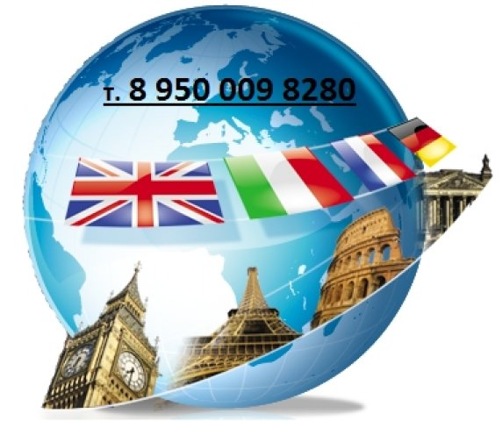
QUIZ EUROPE IN BREAF
Презентацию выполнила учитель английского языка
ГБОУ гимназии №293 Ундруль Наталья Олеговна, г.Санкт-Петербург

Slide 2
EUROPE IN BREAF
COMMON KNOWLEDGE | 10 | 20 | 30 | 40 | 50
EUROPEAN CULTURE | 10 | 20 | 30 | 40 | 50
ABC | 10 | 20 | 30 | 40 | 50
BOOKS AND WRITERS | 10 | 20 | 30 | 40 | 50
EUROPEAN LANGUAGES | 10 | 20 | 30 | 40 | 50
WORLD OF WORDS | 10 | 20 | 30 | 40 | 50

Slide 3
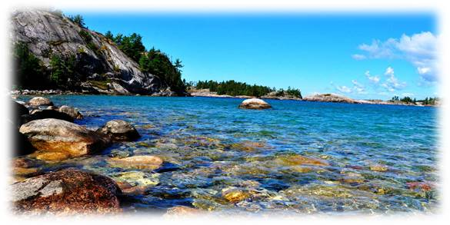
10
COMMON KNOWLEDGE
Name the largest lake in Europe:
a) Lake Balaton in Hungary
b) Lake Vättern in Sweden
c) Lake Saimaa in Finland
d) Lake Ladoga in Russia
© Ундруль Н.О.

Slide 4
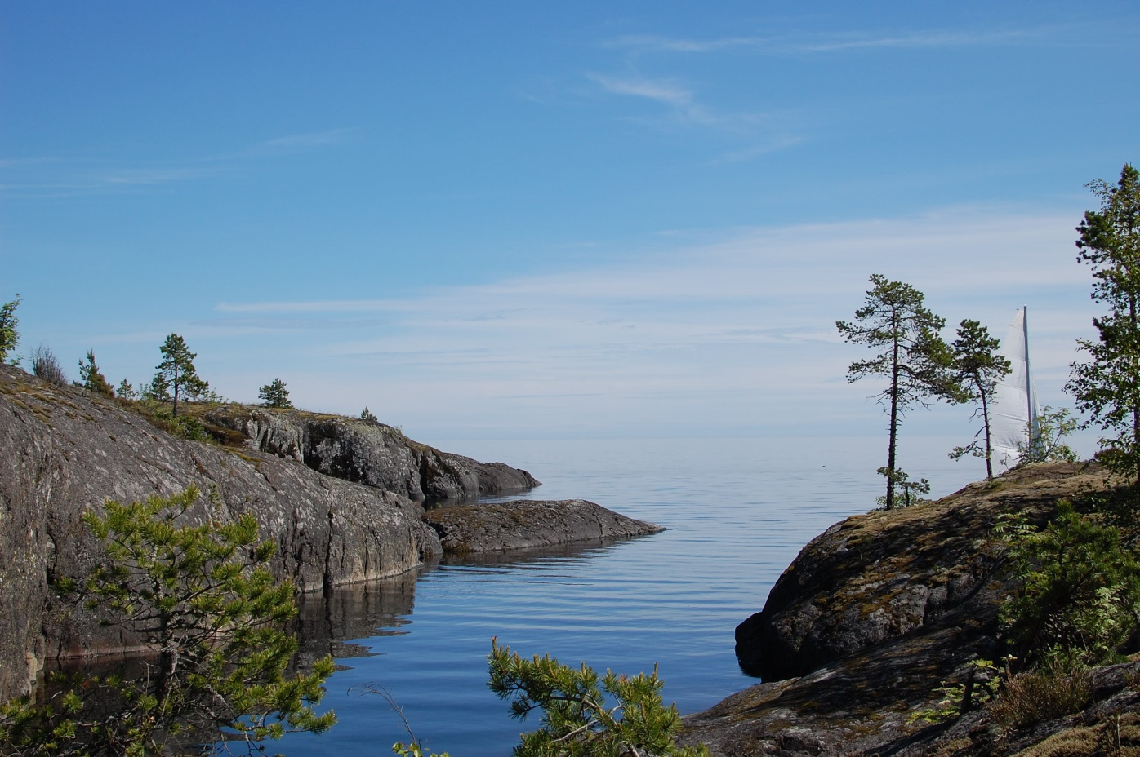
10
COMMON KNOWLEDGE
Lake Ladoga in Russia
© Ундруль Н.О.

Slide 5
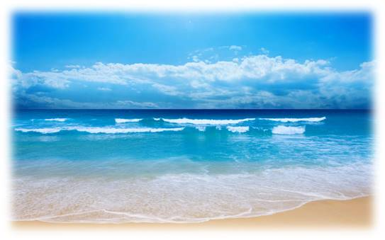
20
COMMON KNOWLEDGE
What oceans is Europe washed by?
a) By the Pacific Ocean and the Indian Ocean
b) By the Atlantic Ocean and the Pacific Ocean
c) By the Atlantic Ocean and the Arctic Ocean
d) By the Arctic Ocean and the Pacific Ocean
© Ундруль Н.О.

Slide 6
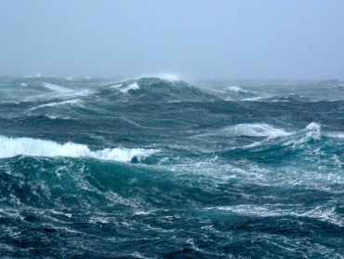
20
COMMON KNOWLEDGE
By the Atlantic Ocean and the Arctic Ocean
© Ундруль Н.О.

Slide 7
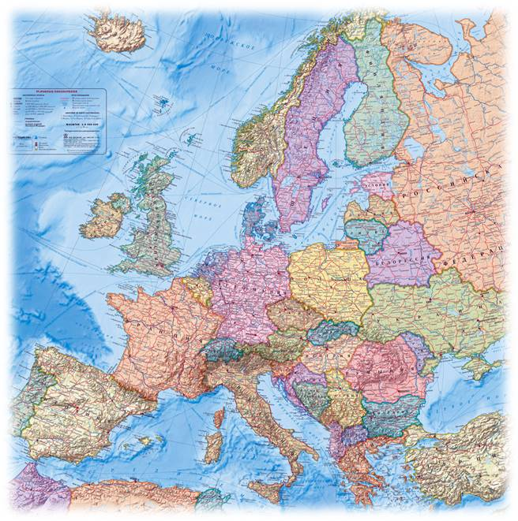
30
COMMON KNOWLEDGE
How many countries are there in Europe?
47
50
52
39
© Ундруль Н.О.

Slide 8
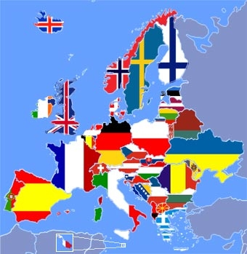
30
COMMON KNOWLEDGE
50
© Ундруль Н.О.

Slide 9
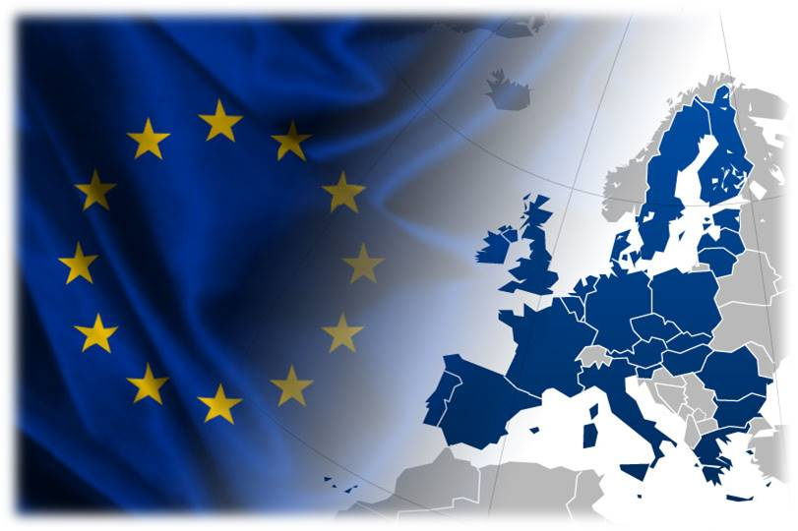
40
COMMON KNOWLEDGE
How many countries are there in European Union?
25
50
28
32
© Ундруль Н.О.

Slide 10
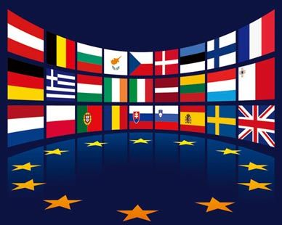
40
COMMON KNOWLEDGE
28
© Ундруль Н.О.

Slide 11
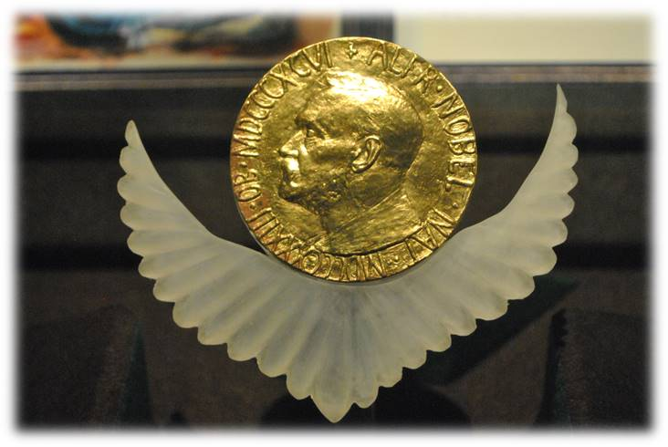
50
COMMON KNOWLEDGE
Name the European country where the Nobel Peace Prize is awarded:
Norway
France
Sweden
Denmark
© Ундруль Н.О.

Slide 12
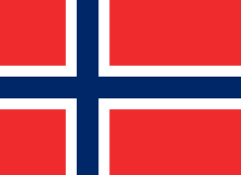
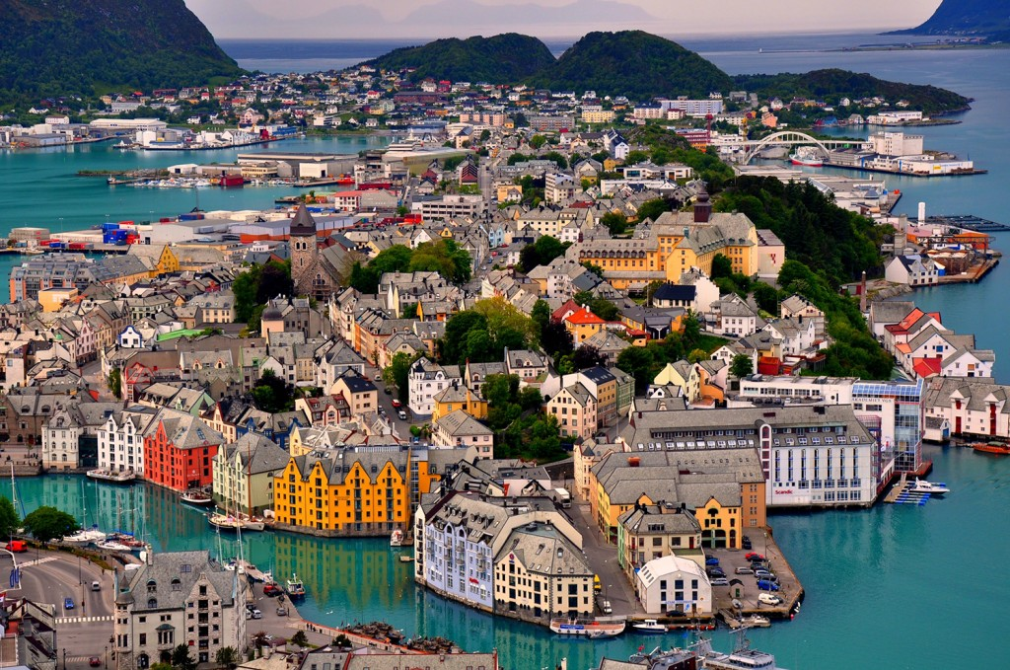
50
COMMON KNOWLEDGE
Norway
The Nobel Peace Prize is awarded in Oslo, the capital of Norway
© Ундруль Н.О.

Slide 13
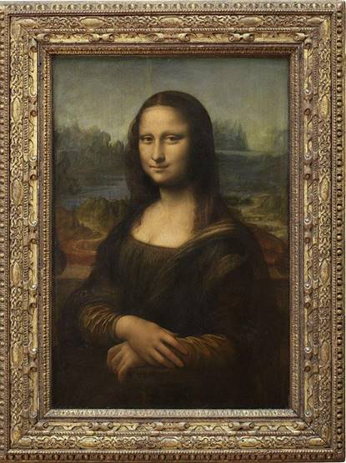
10
EUROPEAN CULTURE
Name the European museum where visitors can see the painting “Mona Lisa” by Leonardo da Vinci:
The Louvre Museum
The Hermitage
Old Masters Picture Gallery
The National Picture Gallery
© Ундруль Н.О.

Slide 14
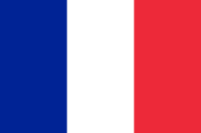
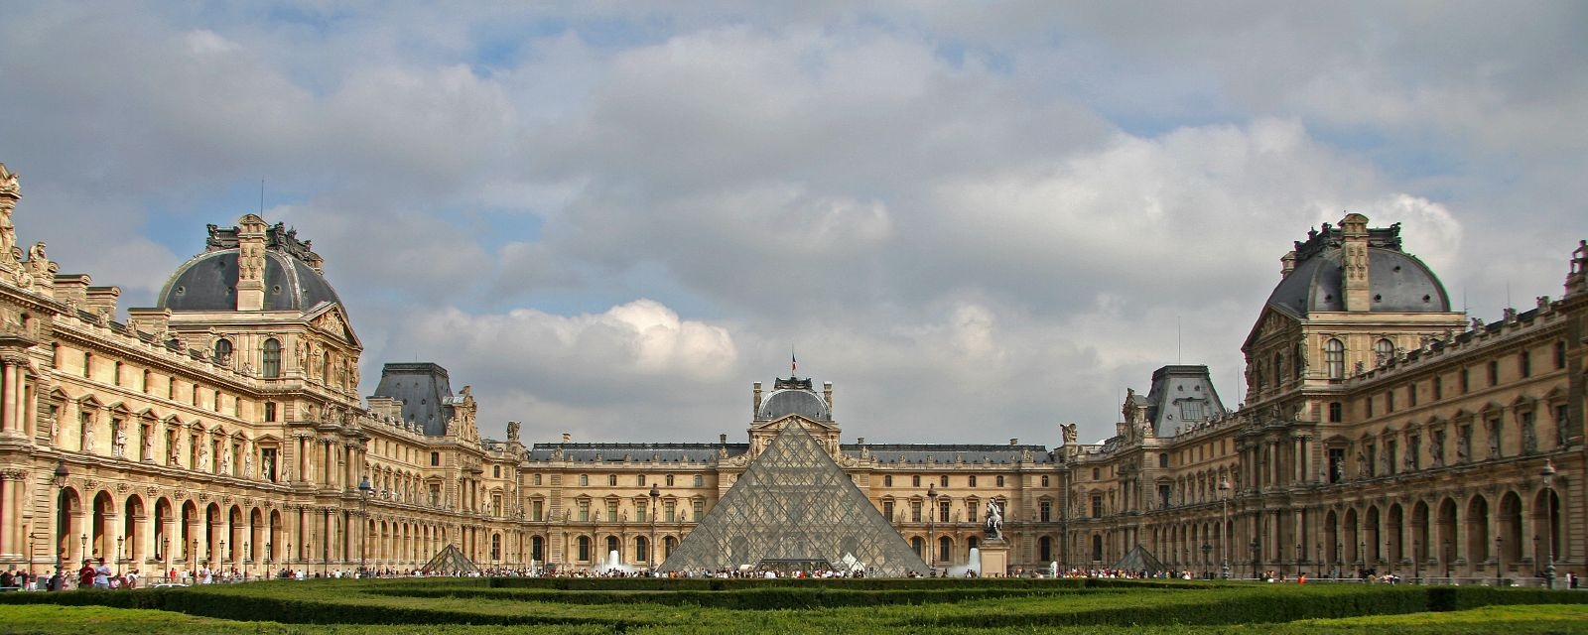
10
EUROPEAN CULTURE
The famous painting “Mona Lisa” is in the Louvre Museum in Paris
© Ундруль Н.О.

Slide 15
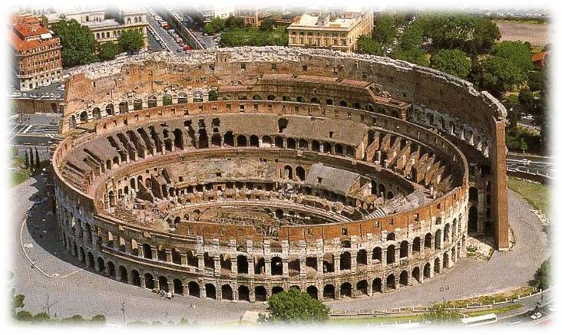
20
EUROPEAN CULTURE
Where is the Colosseum situated?
In London, England
In Berlin, Germany
In Italy, Rome
In Madrid, Spain
© Ундруль Н.О.

Slide 16
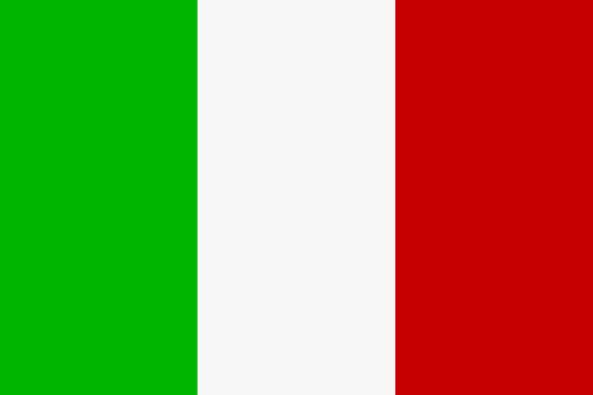
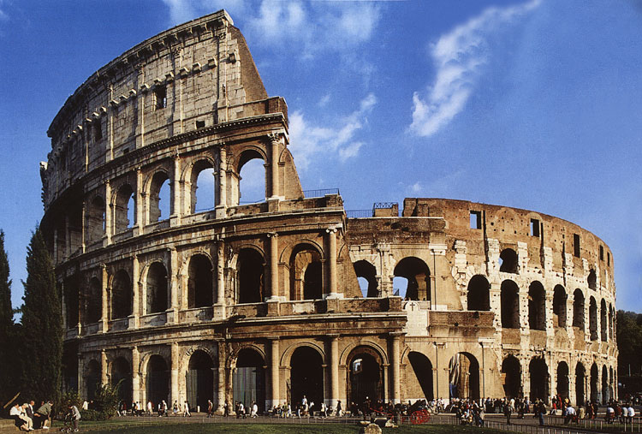
20
EUROPEAN CULTURE
The largest amphitheatre in the world is in Rome the capital of Italy
© Ундруль Н.О.

Slide 17
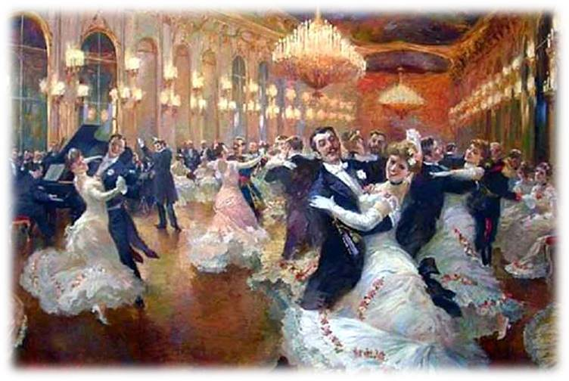
30
EUROPEAN CULTURE
Name the European country where the waltz was first introduced:
Russia
France
Hungary
Austria
© Ундруль Н.О.

Slide 18
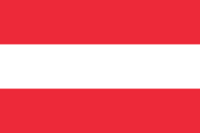
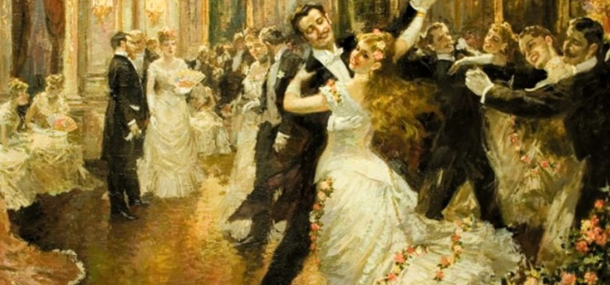
30
EUROPEAN CULTURE
Austria
The waltz became fashionable in Vienna around the 1780s
© Ундруль Н.О.

Slide 19
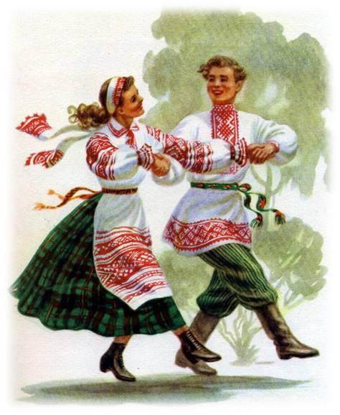
40
EUROPEAN CULTURE
Name the European country where the polka originated:
Czech Republic
Poland
Slovakia
Switzerland
© Ундруль Н.О.

Slide 20
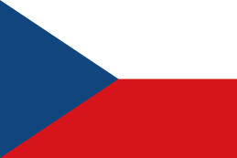
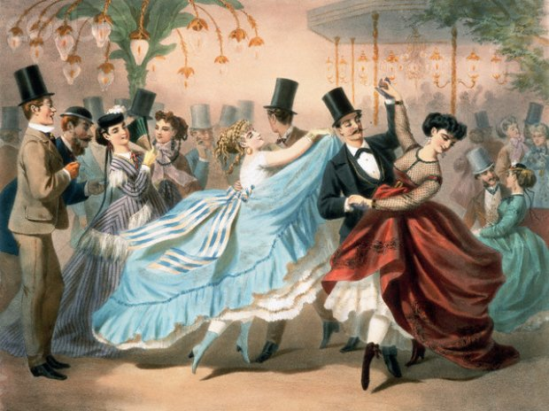
40
EUROPEAN CULTURE
Czech Republic
The dance originated in the middle of the 19th century in Bohemia
© Ундруль Н.О.

Slide 21
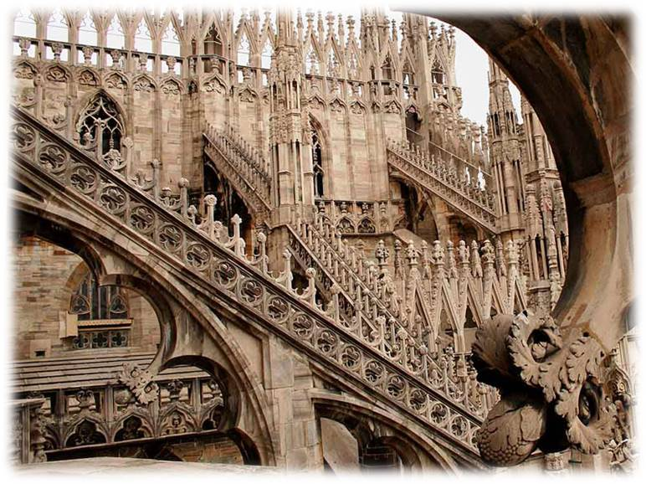
50
EUROPEAN CULTURE
Name the European country where the Gothic style originated:
Germany
France
Austria
Italy
© Ундруль Н.О.

Slide 22
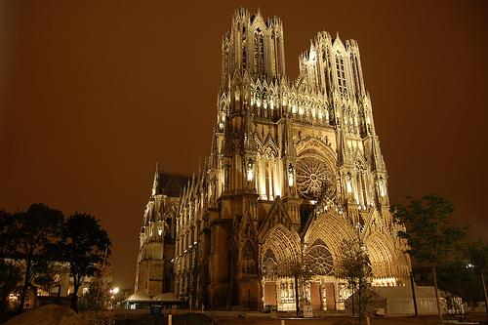
50
EUROPEAN CULTURE
France
Gothic architecture originated in France in 12th century
© Ундруль Н.О.

Slide 23
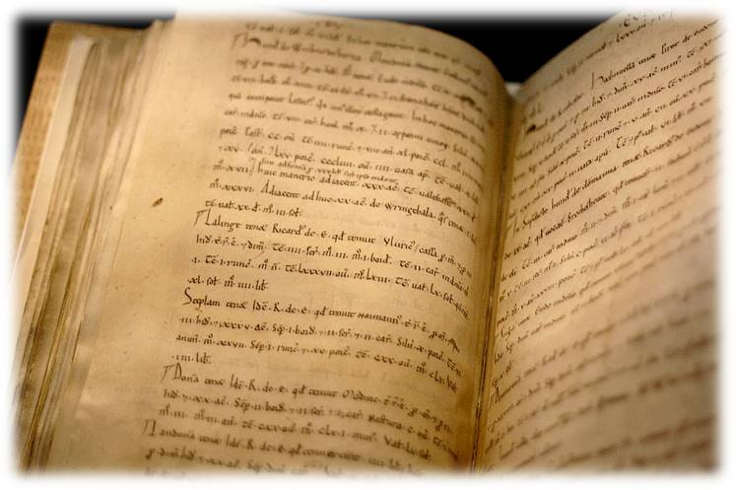
10
ABC
Name the letter of the Latin ABC which was not used in native Latin words:
E
Q
W
I
© Ундруль Н.О.

Slide 24
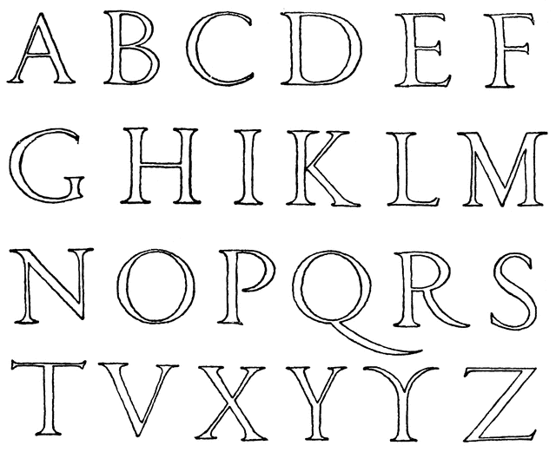
10
ABC
Letter W was missing in the original Latin ABC
© Ундруль Н.О.

Slide 25
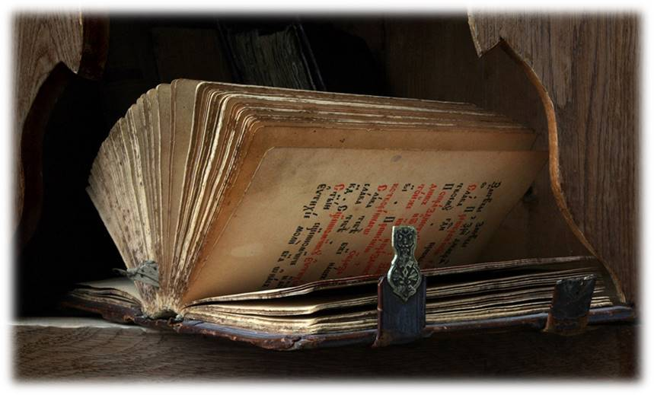
20
ABC
Name the youngest letter in the Russian ABC:
Ъ
Ё
Ю
Ь
© Ундруль Н.О.

Slide 26
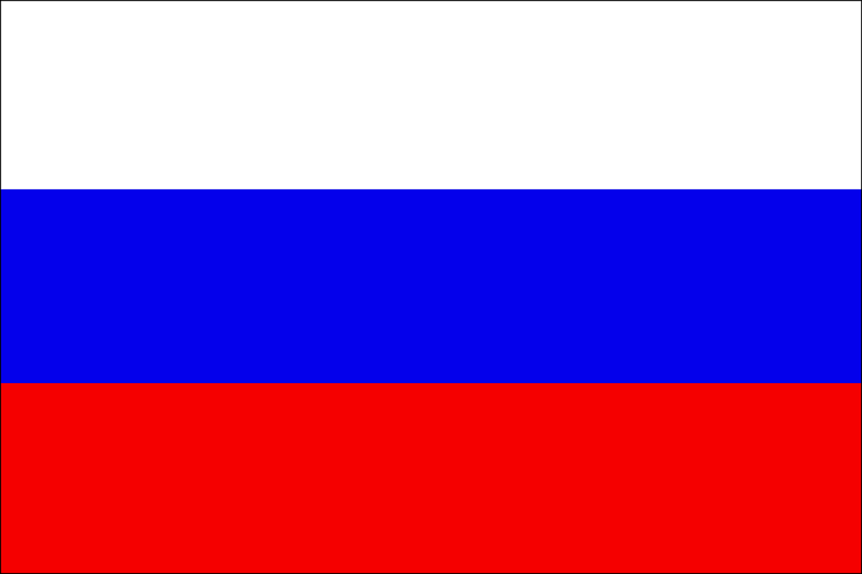
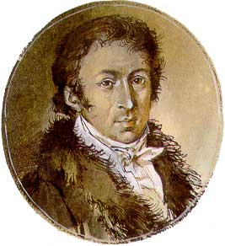
20
ABC
Ё
It was Nikolay Karamzin, a Russian writer, who introduced letter Ё into the Russian alphabet in 1797
© Ундруль Н.О.

Slide 27
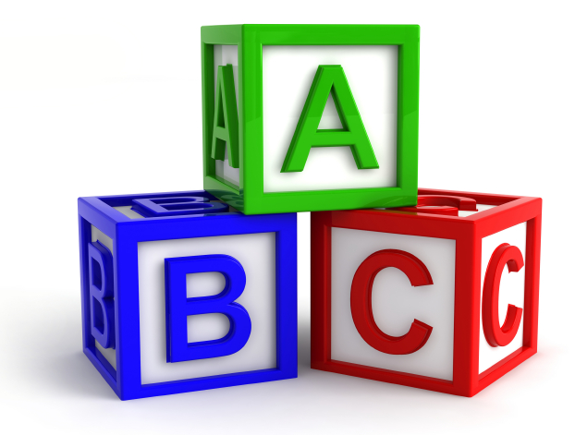
30
ABC
Name the European language which has the shortest ABC:
English
French
German
Italian
© Ундруль Н.О.

Slide 28
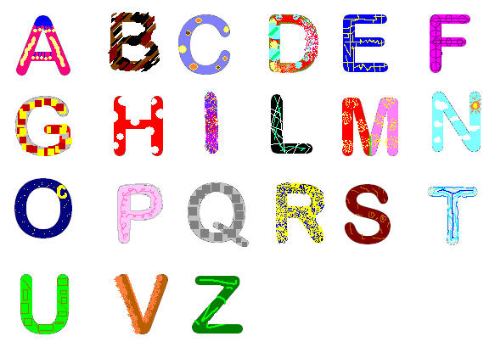
30
ABC
Italian
The English, the French, the German languages have 26 letters and there’re 21 letters in the Italian language
© Ундруль Н.О.

Slide 29
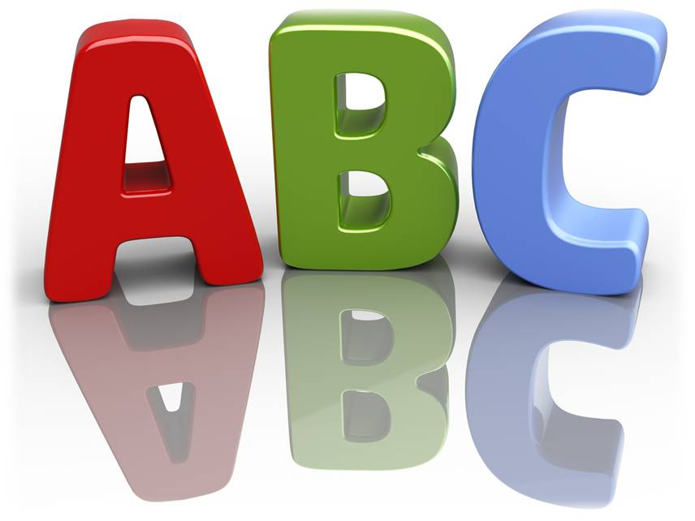
40
ABC
Name the European language which ABC has 36 letters:
Albanian
Belorussian
Estonian
Finnish
© Ундруль Н.О.

Slide 30
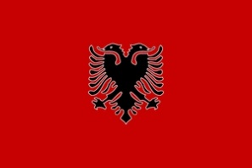
40
ABC
Albanian
There’re 32 letters in the Belorussian and Estonian languages, 31 letter in the Finnish ABC and 36 letters in the Albanian language
© Ундруль Н.О.

Slide 31
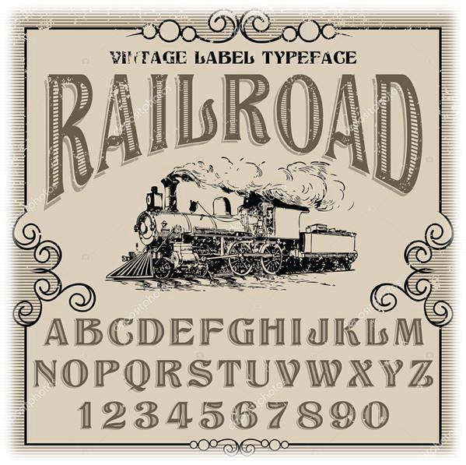
50
ABC
Name the oldest letter in the ABC of many languages:
C
A
O
K
© Ундруль Н.О.

Slide 32
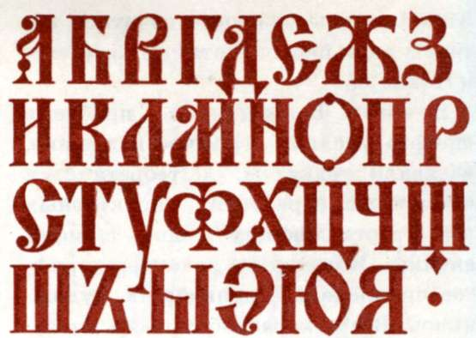
50
ABC
O
Letter O was in the Phoenician ABC in 1300 BC
© Ундруль Н.О.

Slide 33
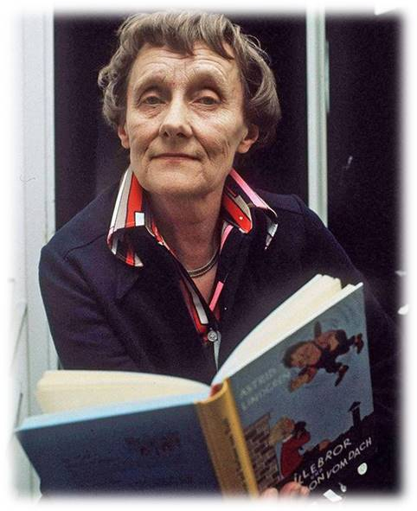
10
BOOKS AND WRITERS
What nationality is Astrid Anna Emilia Lindgren?
A German writer
A Swedish writer
A Finnish writer
A Norwegian writer
© Ундруль Н.О.

Slide 34
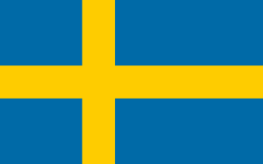
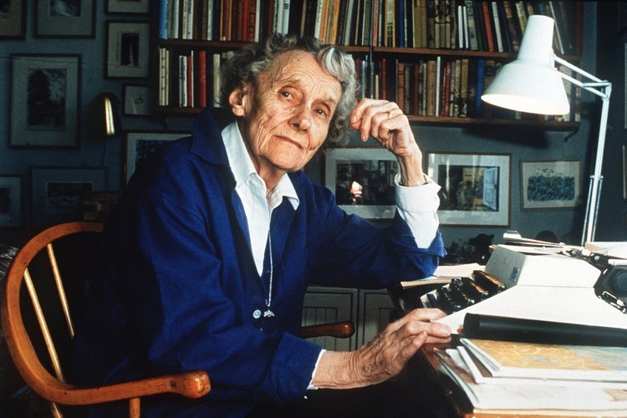
10
BOOKS AND WRITERS
A Swedish writer
© Ундруль Н.О.

Slide 35
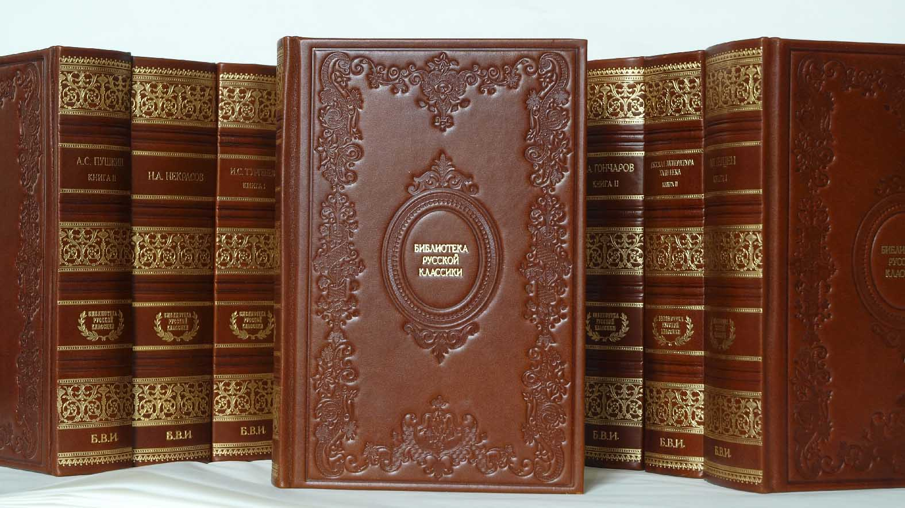
20
BOOKS AND WRITERS
Name the founder of modern Russian literature:
Leo Tolstoy
Sergei Yesenin
Alexander Pushkin
Saints Cyril and Methodius
© Ундруль Н.О.

Slide 36
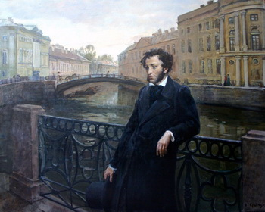
20
BOOKS AND WRITERS
Alexander Pushkin,
the greatest Russian poet
© Ундруль Н.О.

Slide 37
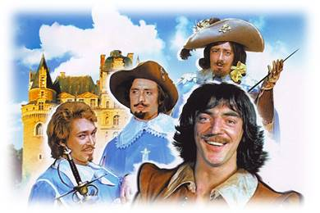
30
BOOKS AND WRITERS
Name the author of the books “The Three Musketeers” and “The Count Of Monte Cristo” :
Alan Alexandre Milne, an English writer
Gianni Rodari, an Italian writer
Hans Christian Andersen, a Danish writer
Alexandre Dumas, a French writer
© Ундруль Н.О.

Slide 38
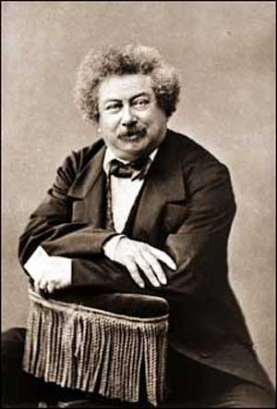
30
BOOKS AND WRITERS
Alexandre Dumas, a French writer
© Ундруль Н.О.

Slide 39
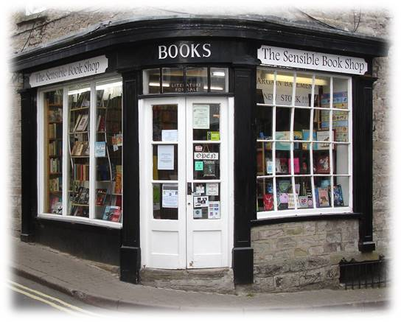
40
BOOKS AND WRITERS
Name the best-selling book of all time:
Harry Potter
The Bible
Romeo and Juliet
The Chronicles of Narnia
© Ундруль Н.О.

Slide 40
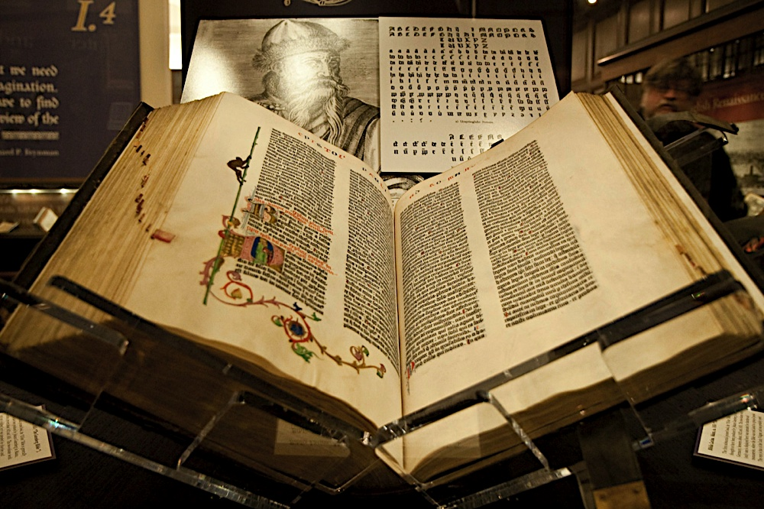
40
BOOKS AND WRITERS
The Bible
It has estimated annual sales of 100 million copies
© Ундруль Н.О.

Slide 41
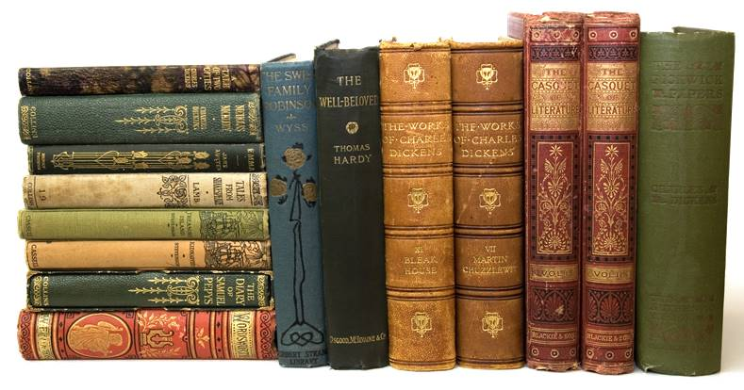
50
BOOKS AND WRITERS
Name the father of the historical novel in the world literature:
Charles Dickens
Sir Walter Scott
Jonathan Swift
Oscar Wilde
© Ундруль Н.О.

Slide 42
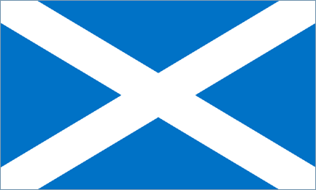
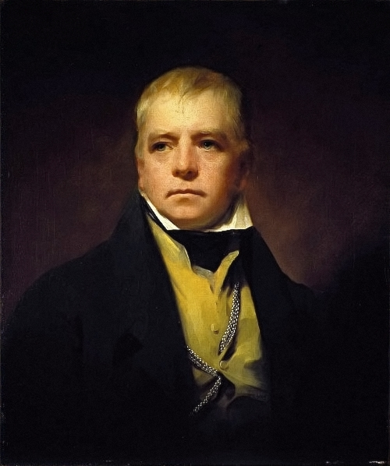
50
BOOKS AND WRITERS
Sir Walter Scott
A Scottish historical novelist, playwright and poet
© Ундруль Н.О.

Slide 43
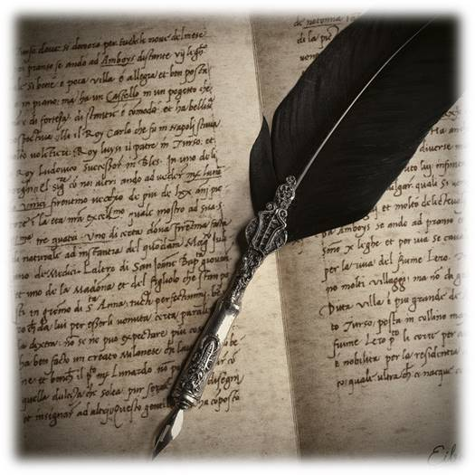
10
EUROPEAN LANGUAGES
Which European language is considered to be the dead language?
Italian
Greek
Latin
Portuguese
© Ундруль Н.О.

Slide 44
10
EUROPEAN LANGUAGES
Latin
© Ундруль Н.О.

Slide 45
20
EUROPEAN LANGUAGES
Which European language does not exist?
Austrian
Bulgarian
Hungarian
Slovak
© Ундруль Н.О.

Slide 46
20
EUROPEAN LANGUAGES
Austrian
In Austria people speak German
© Ундруль Н.О.

Slide 47
30
EUROPEAN LANGUAGES
Name the official language of Vatican City State, the smallest country in the world which is in Europe:
Italian
English
French
No official language
© Ундруль Н.О.

Slide 48
30
EUROPEAN LANGUAGES
The Vatican Constitution has established no official language by law.
© Ундруль Н.О.

Slide 49
40
EUROPEAN LANGUAGES
Name the most widely spoken language in Europe:
Russian
English
Spanish
French
© Ундруль Н.О.

Slide 50
40
EUROPEAN LANGUAGES
The Russian language
It is the largest native language in Europe, with 144 million native speakers in Russia, Ukraine and Belarus
© Ундруль Н.О.

Slide 51
50
EUROPEAN LANGUAGES
Name the language which has the richest vocabulary:
Russian
English
German
French
© Ундруль Н.О.

Slide 52
50
EUROPEAN LANGUAGES
The English language
It comprises about 10 million words
© Ундруль Н.О.

Slide 53
10
WORLD OF WORDS
Name the part of speech in the Russian language which the words “впрок”, “анфас”, “ва-банк” belong to:
Noun
Adjective
Adverb
Verb
© Ундруль Н.О.

Slide 54
10
WORLD OF WORDS
Adverb
В русском языке слова “впрок”, “анфас”, “ва-банк” –наречия, к ним можно задать вопрос “как?”
© Ундруль Н.О.

Slide 55
20
WORLD OF WORDS
Name the European language which doesn’t have the words YES /NO:
Dutch
Swedish
Bulgarian
Scottish Gaelic
© Ундруль Н.О.

Slide 56
20
WORLD OF WORDS
Scottish Gaelic
© Ундруль Н.О.

Slide 57
30
WORLD OF WORDS
What does the English idiom “to have green fingers” mean?
To wear green gloves
To be very good at gardening
To be very interested in the environment
To be ill
© Ундруль Н.О.

Slide 58
30
WORLD OF WORDS
To be very good at gardening
© Ундруль Н.О.

Slide 59
40
WORLD OF WORDS
Name the Russian equivalent to the Polish proverb:
Robota nie zając, w las nie ucieknie.
© Ундруль Н.О.

Slide 60
40
WORLD OF WORDS
Robota nie zając, w las nie ucieknie
Работа – не волк, в лес не убежит
© Ундруль Н.О.

Slide 61
50
WORLD OF WORDS
What do the words “Чумацький шлях” in the Ukrainian language mean:
Млечный путь
Очаровательная шляпа
Весёлое путешествие
Бубонная чума
© Ундруль Н.О.

Slide 62
50
WORLD OF WORDS
Чумацький шлях – Млечный путь
© Ундруль Н.О.

Slide 63
RECOURSES
1. Ундруль Н.О. Статья: http://festival.1september.ru/articles/644558
2. http://en.wikipedia.org/wiki/Russian_language
3. http://yandex.ru/images/search
4. http://www.123greetings.com/world_languages/
5. https://lingos.co/blog/russian-10-reasons-may-want-learn-russian/

